Slide 1

Synopsis Presentation
For Project Based Learning
Robotics and Automation
Batch 2022-26
Intelligent Smart Precision Agriculture with IoT & Machine Learning
Presented By:
Akshat Singh (22070127009)
Bibi Mehnoor (22070127015)
Himonish Gupta (22070127025)
Yash Golani (22070127072)
Guide Name:
Dr. Rajesh Bisane
Assistant Professor
Department of Robotics and Automation
Symbiosis Institute of Technology, Pune
2024-25

Slide 2
Outlines of Presentation
Introduction
Literature Review
Statement of Problem
Objectives
Methodology
Tentative Budget Details
Tentative Work Plan
Expected Outcomes
Department of Robotics and Automation Engineering Third Year (B.Tech.)

Slide 3
Introduction
Agriculture is the backbone of many economy, and with increasing global food demands, integrating smart technologies into farming practices has become essential. Intelligent precision agriculture leverages IOT, machine learning, and embedded systems to enhance productivity, optimise resource usage, and reduce manual effort.
Hydroponics: A Soilless Plant Cultivation Method
• Hydroponics is a method of growing plants without soil, using a water-based nutrient solution.
• It is a subset of CEA , allowing precise control over growth conditions.
• Ideal for urban farming and areas with limited land availability.
• Beneficial for regions with poor or contaminated soil.
• Uses significantly less water compared to traditional farming, addressing water scarcity concerns.
• Promotes faster plant growth and higher productivity due to optimized nutrient delivery.
Department of Robotics and Automation Engineering Third Year (B.Tech.)

Slide 4
Rationale & Significance of the Study
Rationale of the Study:
Agriculture plays a crucial role in food security, economic growth, and environmental sustainability. However, traditional farming methods face challenges such as climate change, inefficient resource utilization, labor shortages, and unpredictable crop yields. The integration of smart technologies into agriculture is essential to address these issues and enhance productivity.
Significance of the Study:
The integration of ESP32, IoT & Machine Learning in Hydroponic Agriculture presents a groundbreaking shift in modern farming techniques. This study is significant in multiple domains, including agriculture, technology, sustainability, and food security.
Department of Robotics and Automation Engineering Third Year (B.Tech.)

Slide 5
Current Trends of Study
Smart hydroponics integrates ML, IoT, and automation to enhance precision farming. Machine learning predicts plant growth, detects diseases, and optimizes nutrient delivery.
IoT sensors monitor environmental conditions, while ESP32 automates irrigation and climate control.
Vertical farming is expanding with blockchain for traceability and cloud computing for remote monitoring.
Robotics assist in automated harvesting, and hydroponics is being explored for space missions and extreme climates, making it a sustainable, high-yield solution for modern agriculture.
Department of Robotics and Automation Engineering Third Year (B.Tech.)

Slide 6
LITERATURE REVIEW
S.no | Author(s) | Paper Title | Year | Methodology | Research Gap
1. | Singh & Verma | Hydroponic Farming using AI and IoT | 2022 | Used ESP32 to collect sensor data. Sent data to Firebase for real-time monitoring. Applied CNN for plant health classification. | Limited exploration of deep learning models for enhancing crop prediction accuracy and real-time decision-making.
2. | Ahmad et al. | Smart Irrigation System using ESP32 and IoT | 2021 | Developed an IoT-based system with ESP32, DHT11, and soil moisture sensors. Used ThingSpeak for visualization and threshold-based irrigation control. | No machine learning was applied for predicting plant health or automating decisions.
3. | Sharma & Gupta | AI-driven Precision Agriculture with ESP32 | 2023 | Implemented an ESP32-based smart farming system.Used Firebase for remote monitoring. Applied basic rule-based automation for water pumps. | Did not integrate advanced predictive models like LSTM for optimizing plant growth.
Department of Robotics and Automation Engineering Third Year (B.Tech.)

Slide 7
LITERATURE REVIEW
S.no | Author(s) | Paper Title | Year | Methodology | Research Gap
4. | L. T. Pereira, A. T. Silva | Precision Agriculture System using Raspberry Pi and AI for Sustainable Farming | 2023 | Raspberry Pi, Machine Learning (Artificial Neural Networks, K-Nearest Neighbors), Computer Vision, IoT Sensors | Limited application of computer vision techniques for real-time crop health assessment and automated anomaly detection .
5. | J. K. Sharma, S. K. Singh | Automated Smart Agriculture using Raspberry Pi and IoT with Machine Learning | 2022 | Raspberry Pi, IoT Sensors, Machine Learning (Logistic Regression, SVM), Automation (Irrigation Control), Remote Monitoring | Absence of real-time adaptive machine learning models that dynamically adjust irrigation and fertilization based on changing environmental conditions.
Department of Robotics and Automation Engineering Third Year (B.Tech.)

Slide 8
Statement of the Problem
Traditional farming methods result in inefficient water usage, poor crop yield, and reduced productivity. This project proposes an IoT-based system to monitor soil conditions, optimize irrigation, and use ML for crop yield.
Following are the problems which are currently being faced:
Inefficient resource usage due to lack of real-time monitoring.
Excessive water wastage from unoptimized irrigation.
Limited technological adoption in farming.
Department of Robotics and Automation Engineering Third Year (B.Tech.)

Slide 9
Scope
Develop an IoT-ML-based smart farming system.
Optimize irrigation with real-time monitoring.
Improve crop health with ML-based detection.
Create a cost-effective, energy-efficient solution.
Department of Robotics and Automation Engineering Third Year (B.Tech.)

Slide 10
Objectives
To develop an IoT-based smart agriculture system.
To conduct predictive analysis using machine learning algorithms.
To evaluate the system’s performance in improving crop yield.
Department of Robotics and Automation Engineering Third Year (B.Tech.)

Slide 11
Methodology
Research Study and Analysis
System Testing
Optimization
Component Selection
Machine Learning Model Development
Final Evaluation
Hardware Integration
Data Acquisition
Result & Discussion
Department of Robotics and Automation Engineering Third Year (B.Tech.)

Slide 12
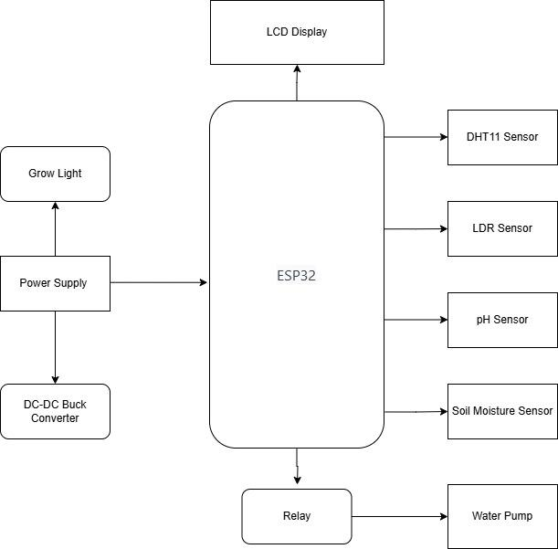
Block Diagram
Department of Robotics and Automation Engineering Third Year (B.Tech.)

Slide 13
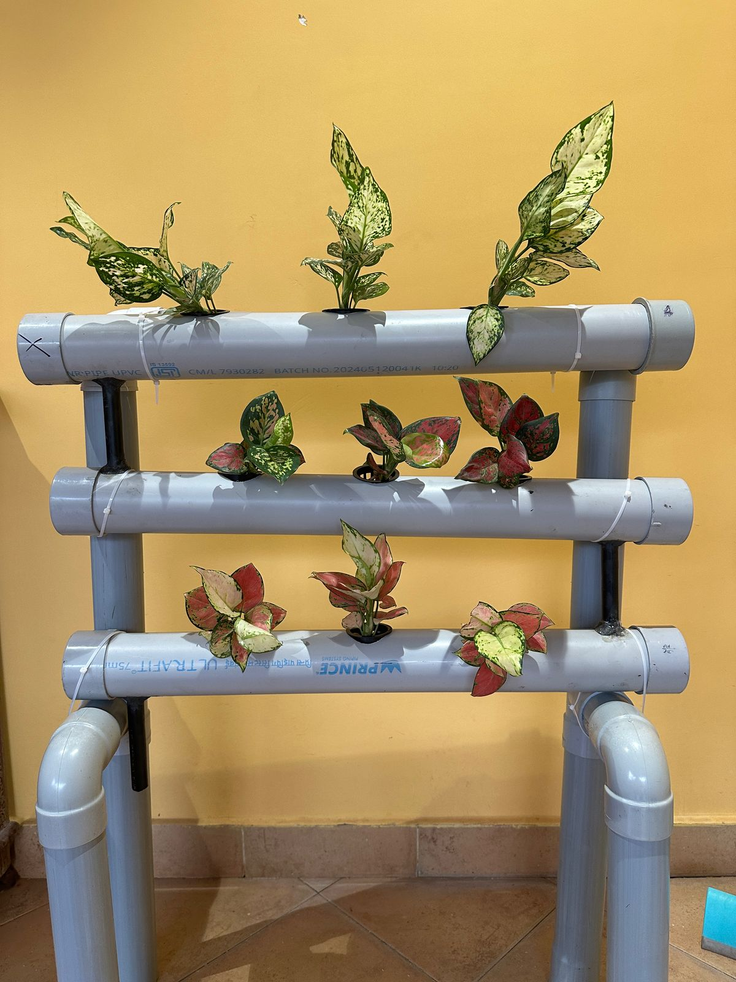
System Structure Overview
The Intelligent Smart Precision Agriculture uses sensors, controllers, and actuators to automate farming efficiently. Water circulates through plant pipes, ensuring continuous nutrient flow. Aglaonema, an air-purifying plant, thrives in controlled conditions with optimal moisture, light, and pH levels. Automated irrigation and lighting maintain healthy growth while minimizing resource wastage.
Frame Support:
Vertical: 6 pipes (18” x 2.5”)
Horizontal: 1 pipe (26” x 2.5”)
Joints: 2 T-joints (2.5”), 4 elbow joints (2.5”)
Plant Holding & Water Circulation:
Plant Pipes: 3 pipes (30” x 2.5”) with net basket openings
Water Flow: 3 pipes (5” x 1”), 1 tube (15”) for pump connection
End Caps: 6 (3” x 2.5”) to prevent leaks
Support & Fastening:
Net Baskets: 9 (2” diameter) for plant roots
Zip Ties: Secure pipes to frame
Department of Robotics and Automation Engineering Third Year (B.Tech.)

Slide 14
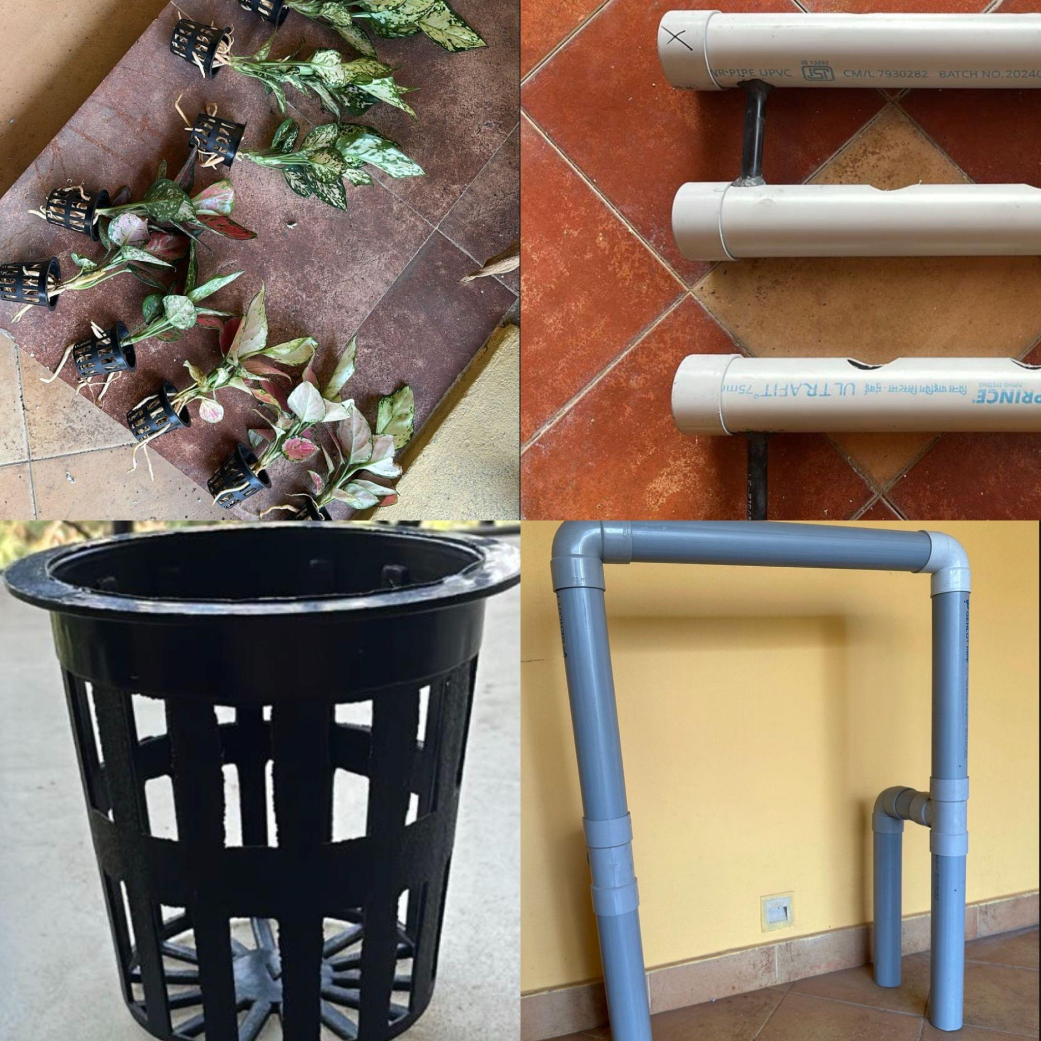
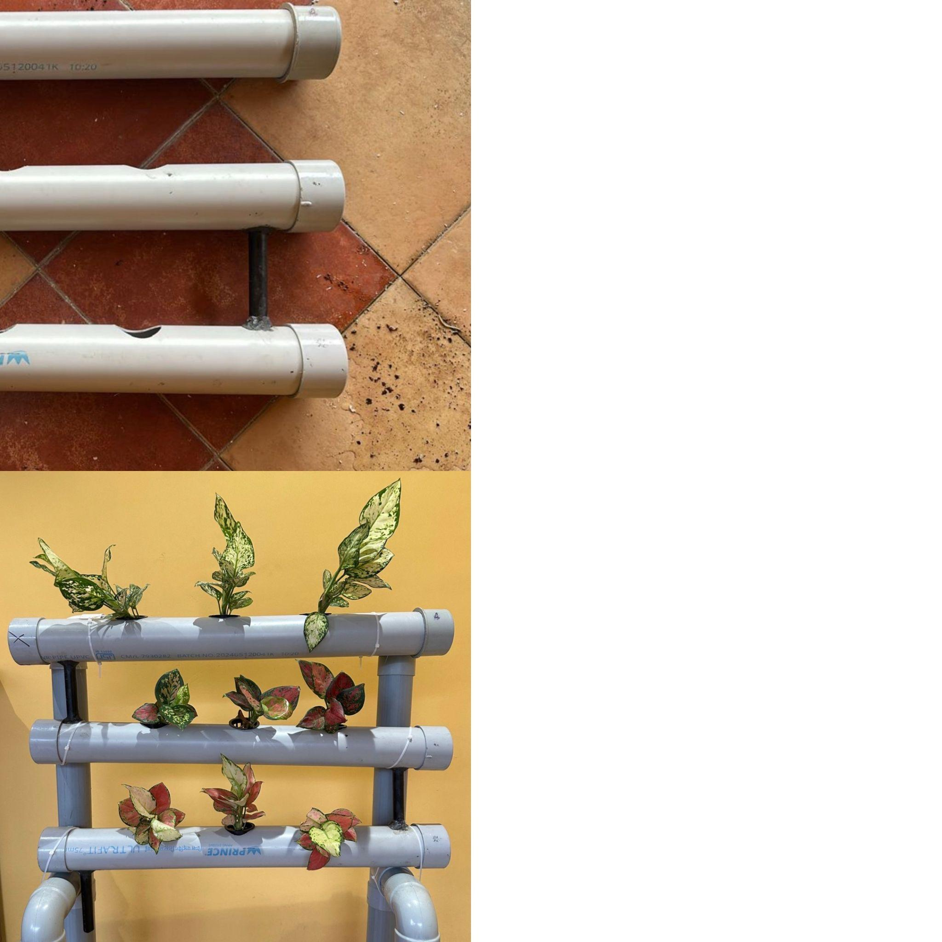
System Structure Overview
Department of Robotics and Automation Engineering Third Year (B.Tech.)

Slide 15
Sensor Integration
1. ESP32 (Wi-Fi & Bluetooth Enabled Microcontroller)
A low-power, high-performance microcontroller with built-in Wi-Fi and Bluetooth connectivity.
Supports IoT applications by integrating with Firebase, ThingSpeak & cloud-based ML models.
2. DHT11 Sensor (Temperature & Humidity)
Measures environmental conditions affecting plant growth.
Helps in climate control by activating fans, heaters, or misting systems.
3. LDR Sensor (Light Dependent Resistor)
Monitors light intensity for optimal plant growth.
Can automate grow lights based on natural sunlight availability.
4. Single-Channel Relay Module (5V, 10A)
Controls electrical components like water pumps, fans, or grow lights.
Ensures automation of irrigation and lighting based on sensor feedback.
Department of Robotics and Automation Engineering Third Year (B.Tech.)

Slide 16
6. Soil Moisture Sensor (Smart Elex Sensor)
Detects soil hydration levels to optimize irrigation schedules.
Prevents water wastage and ensures plants receive the right amount of moisture.
7. pH Sensor (Electrode Probe for Liquid pH Value)
Monitors soil or hydroponic nutrient solution pH levels.
Helps maintain optimal pH for plant growth, preventing nutrient deficiencies.
8. DC-DC Buck Converter (LM2596S)
Regulates power supply to sensors and other components.
Ensures stable voltage for Raspberry Pi and peripherals.
9. Power Supply (AC-DC Power Module, 24V 4A)
Provides necessary power for Raspberry Pi and other components.
Ensures uninterrupted operation of the smart farming system.
10. LCD Display (16x2, Green Backlight)
Displays real-time sensor data like temperature, moisture levels, and pH.
Helps farmers monitor conditions without needing a separate computer.
Department of Robotics and Automation Engineering Third Year (B.Tech.)

Slide 17
Sensor Integration
Power Supply | Converts AC to DC using an SMPS and a Buck Converter to ensure stable power.
ESP32 | Serves as the central unit for collecting, processing, and transmitting sensor data.
Sensors | Monitors essential factors like temperature, humidity, soil moisture, pH, and light levels.
Relay Module | Controls devices like the water pump, making automation seamless.
LCD Display | Provides real-time updates, keeping users informed about system status.
Department of Robotics and Automation Engineering Third Year (B.Tech.)

Slide 18
Sensor Integration
1. DHT11 Sensor (Temperature & Humidity)
Connected to GPIO 16. Monitors temperature and humidity for Aglaonema growth.
2. Soil Moisture Sensor
Connected to GPIO 32 (Analog Input).
Detects soil moisture levels to trigger irrigation.
3. pH Sensor
Connected to GPIO 13 (Analog Input). Maintains correct soil pH for plant health.
4. LDR Sensor (Light Sensor)
Connected to GPIO 5 (Analog Input) with a 10kΩ pull-up resistor.
Detects ambient light to control grow lights.
5. Water Pump & Relay Module
Relay module connected to GPIO 14. Automates irrigation based on soil moisture.
Department of Robotics and Automation Engineering Third Year (B.Tech.)

Slide 19
Sensor Integration
6. LCD Display (16x2, Green Backlight)
Connected via I2C (SDA: GPIO 34, SCL: GPIO 35). Displays real-time sensor data.
7. DC-DC Buck Converter & Power Supply
Converts 24V to 5V for a stable power supply to ESP32 and other connected components.. Ensures proper voltage regulation.
Key Benefits of IoT in Agriculture
Real-time Monitoring & Control | Sensors continuously track environmental conditions such as temperature, humidity, soil moisture, and light levels.
Dashboard Access | Farmers can monitor irrigation systems, greenhouse conditions, or adjust settings using web dashboards or mobile apps
Data Storage & Analysis | Collected sensor data is stored in the cloud, allowing predictive analytics and optimized decision-making.
Department of Robotics and Automation Engineering Third Year (B.Tech.)

Slide 20
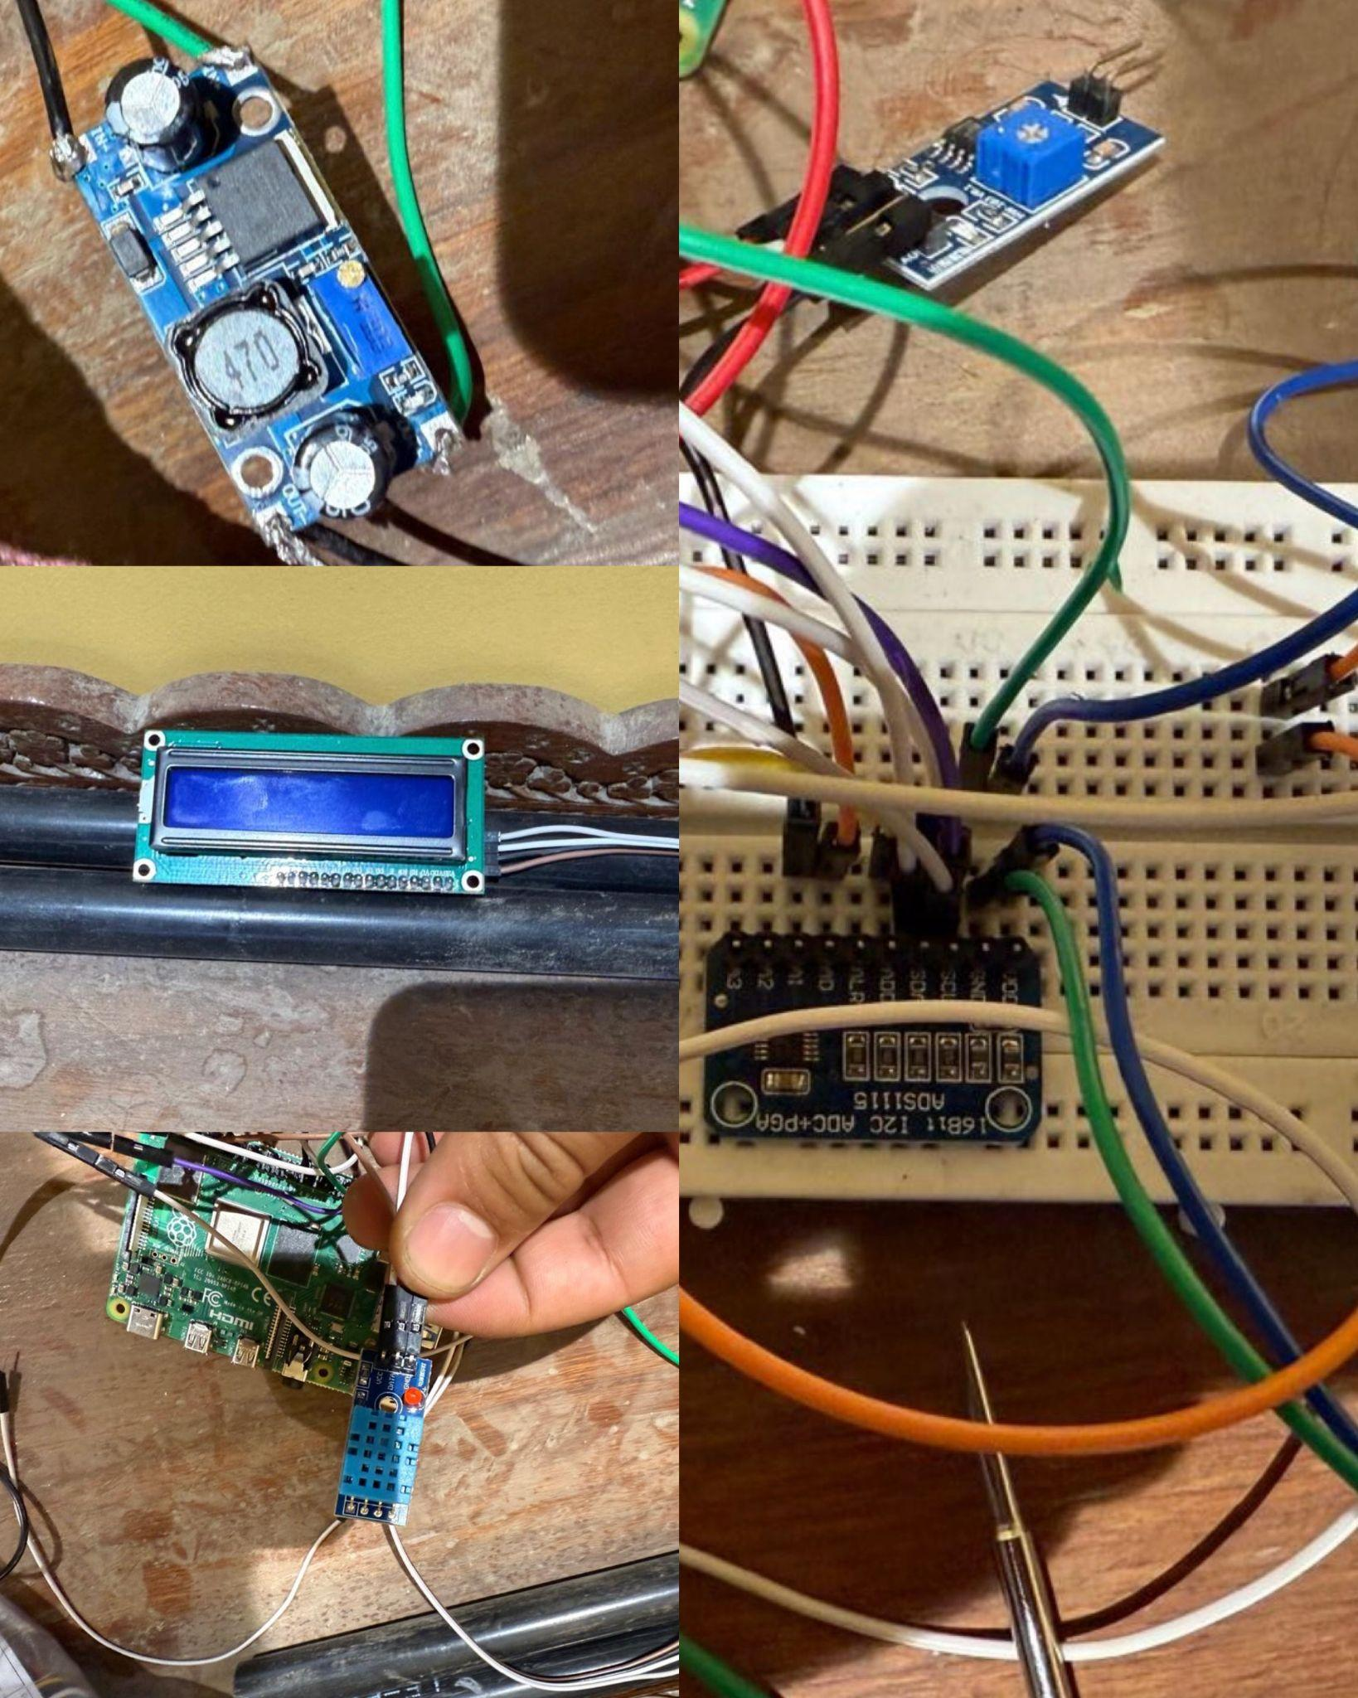
Sensor Integration
Department of Robotics and Automation Engineering Third Year (B.Tech.)

Slide 21
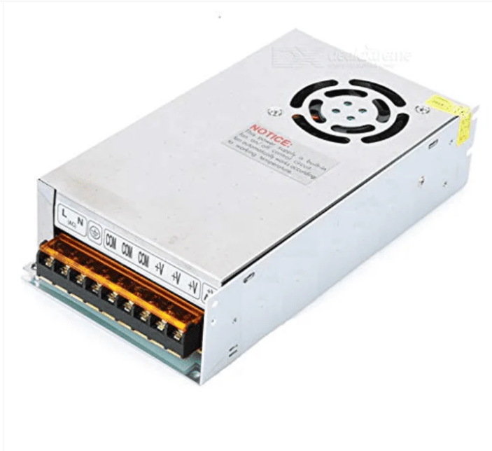
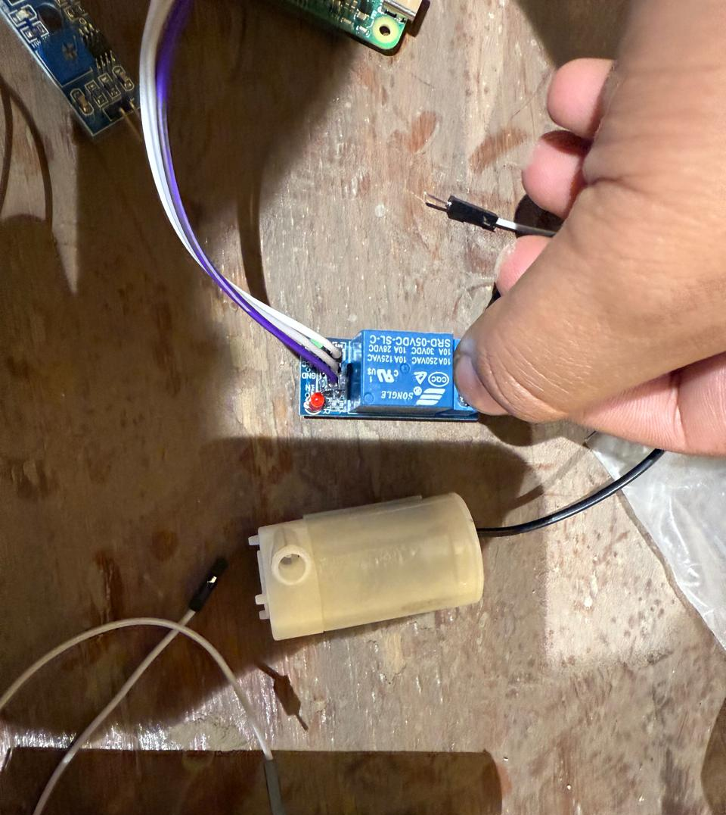
Sensor Integration
Department of Robotics and Automation Engineering Third Year (B.Tech.)

Slide 22
Comparison
Feature | Traditional Hydroponic Systems | Proposed Esp32-based System
Automation Level | Manual or semi-automated with timers | Fully automated using IoT and ML
Data Collection | Limited sensor integration | Real-time data from multiple sensors
Decision Making | Requires human intervention | ML-based decision making
Remote Monitoring | Often unavailable or expensive | Cloud-based remote access
Energy Efficiency | High energy consumption | Optimized power usage with smart controls
Scalability | Hard to expand | Easily scalable with additional sensors
Why ESP32 for Cloud & IoT-Based Hydroponics?
Cloud Integration – Sends real-time sensor data to Firebase and ThingSpeak for remote monitoring.
IoT Gateway – Connects multiple sensors via Wi-Fi, ensuring reliable data transmission.
Edge Computing – Processes data locally, reducing cloud dependency.
AI & ML – Runs TensorFlow Lite models for automated irrigation and lighting control.
Department of Robotics and Automation Engineering Third Year (B.Tech.)

Slide 23
Comparison
Feature | ESP32 | Arduino | Raspberry Pi 4B
Processing Power | Medium (Dual-core 240MHz) | Very low (Single-core 16MHz) | High (Quad-core 1.5GHz)
Multitasking | Yes (FreeRTOS support) | No multitasking | Full multitasking (Linux OS)
Cloud Integration | Yes (via Wi-Fi) | Needs external modules | Advanced cloud integration
Machine Learning | Limited (TensorFlow Lite) | Not supported | Supports TensorFlow & OpenCV
Peripheral Support | High (Multiple ADC, I2C, SPI, PWM, UART) | Very limited GPIO | Multiple USB, HDMI, and GPIO
Storage | Limited Flash memory | Limited EEPROM | Expandable microSD & USB
Power Consumption | Low | Very Low | Moderate, but supports high-performance tasks
Department of Robotics and Automation Engineering Third Year (B.Tech.)

Slide 24
Firebase is a cloud-based platform by Google that provides real-time database storage, cloud functions, and authentication services. It enables seamless integration with IoT devices like ESP32, allowing sensor data to be stored, accessed, and analyzed remotely. In this project, Firebase is used to collect temperature, humidity, soil moisture, pH, and light intensity data for monitoring and automation.
Setting Up Firebase for ESP32
Create a Firebase Project – Go to the Console, create a new project, and enable Realtime Database.
Enable Realtime Database – Set database rules to test mode for easy read/write access.
Obtain API Credentials – Copy the Database URL and Secret Key for ESP32 integration.
Install Firebase Libraries – Use FirebaseESP32.h in Arduino IDE for communication.
Write Sensor Data to Firebase – ESP32 collects data and uploads it in real time.
Visualize & Analyze Data – Firebase allows access through a dashboard or integration with analytics tools.
Firebase helps us to achieve real-time monitoring, cloud storage, and automated decision-making for intelligent smart precision agriculture.
Firebase Setup
Department of Robotics and Automation Engineering Third Year (B.Tech.)

Slide 25
ThingSpeak is an IoT analytics platform that enables real-time data visualization and cloud storage. It allows ESP32 to send sensor data (temperature, humidity, soil moisture, pH, and light intensity) and view trends through interactive graphs. With ThingSpeak, we can monitor hydroponic conditions remotely and automate responses based on analytics.
Setting Up Firebase for ESP32
Create a ThingSpeak Account – Sign up at ThingSpeak.com and create a new channel.
Configure Fields – Add fields for temperature, humidity, soil moisture, pH, and light.
Obtain API Key – Copy the Write API Key for sending data from ESP32.
Install Required Libraries – Use ThingSpeak.h in Arduino IDE for communication.
Send Sensor Data – ESP32 reads values and updates ThingSpeak every few seconds.
Visualize & Analyze Data – View live graphs and set alerts for threshold values.
ThingSpeak helps us to achieve real-time monitoring and cloud analytics for intelligent smart precision agriculture.
ThingSpeak Setup
Department of Robotics and Automation Engineering Third Year (B.Tech.)

Slide 26
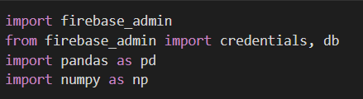
Why Google Colab ?
Google Colab provides a cloud-based environment for running Python code, making it ideal for developing and training machine learning models for hydroponics. It supports TensorFlow, data visualization, and seamless integration with Firebase and ThingSpeak.
Code Implementation
Set Up Environment – Import required libraries like TensorFlow, NumPy, Pandas.
ML Model Development
Department of Robotics and Automation Engineering Third Year (B.Tech.)

Slide 27
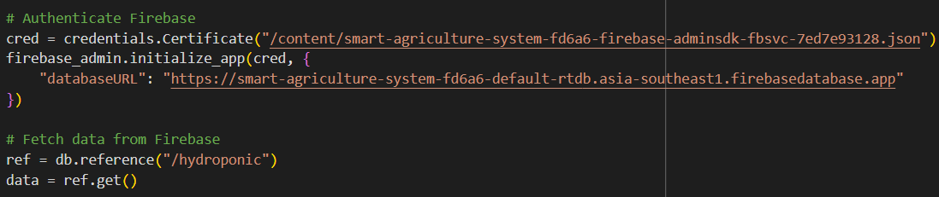
2. Connect firebase – Provide the authentication for firebase.
ML Model Development
Department of Robotics and Automation Engineering Third Year (B.Tech.)

Slide 28

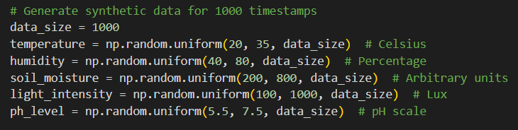
3. Load Sensor Data – Upload CSV files or fetch real-time data from Firebase.
ML Model Development
Department of Robotics and Automation Engineering Third Year (B.Tech.)

Slide 29
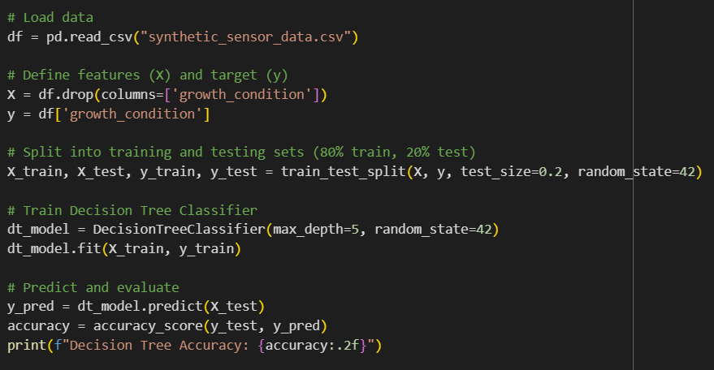
4. Preprocess Data – Normalize, clean, and split the dataset for training.
5. Train Machine Learning Model – Use Decision Trees to predict plant needs.
ML Model Development
Department of Robotics and Automation Engineering Third Year (B.Tech.)

Slide 30
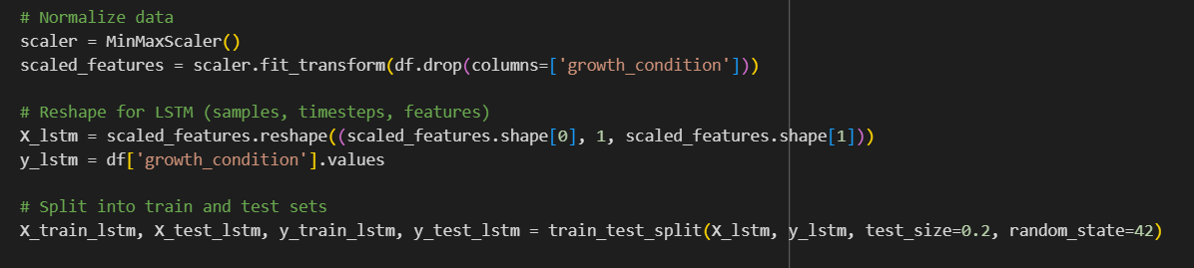
4. Preprocess Data – Normalize, clean, and split the dataset for training.
5. Train Machine Learning Model – Use LSTM for time series analysis.
ML Model Development
Department of Robotics and Automation Engineering Third Year (B.Tech.)

Slide 31
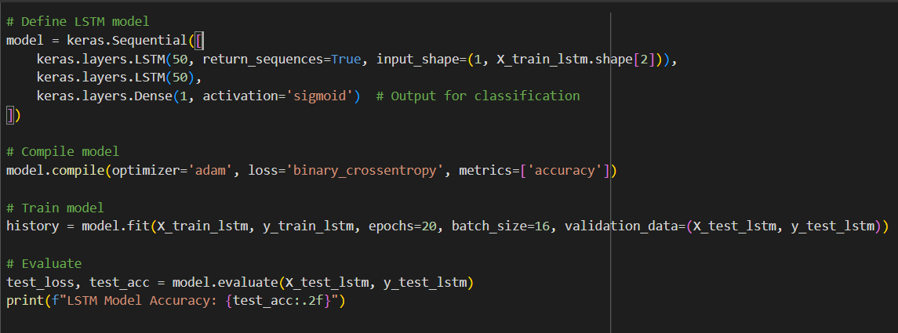
ML Model Development
Department of Robotics and Automation Engineering Third Year (B.Tech.)

Slide 32
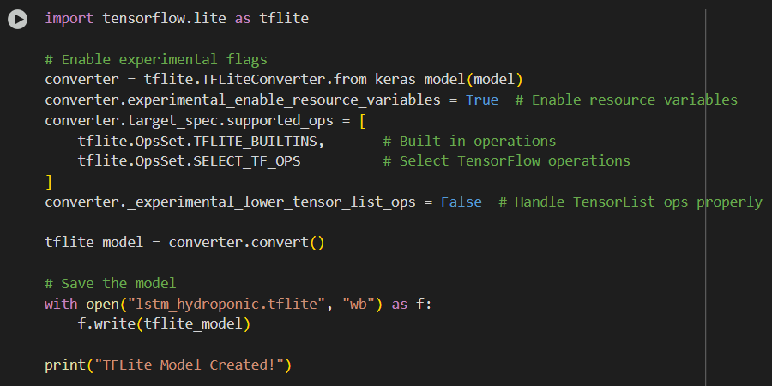
6. Convert & Export Model – Convert the trained model to TensorFlow Lite (.tflite) format for deployment on ESP32.
ML Model Development
Department of Robotics and Automation Engineering Third Year (B.Tech.)

Slide 33
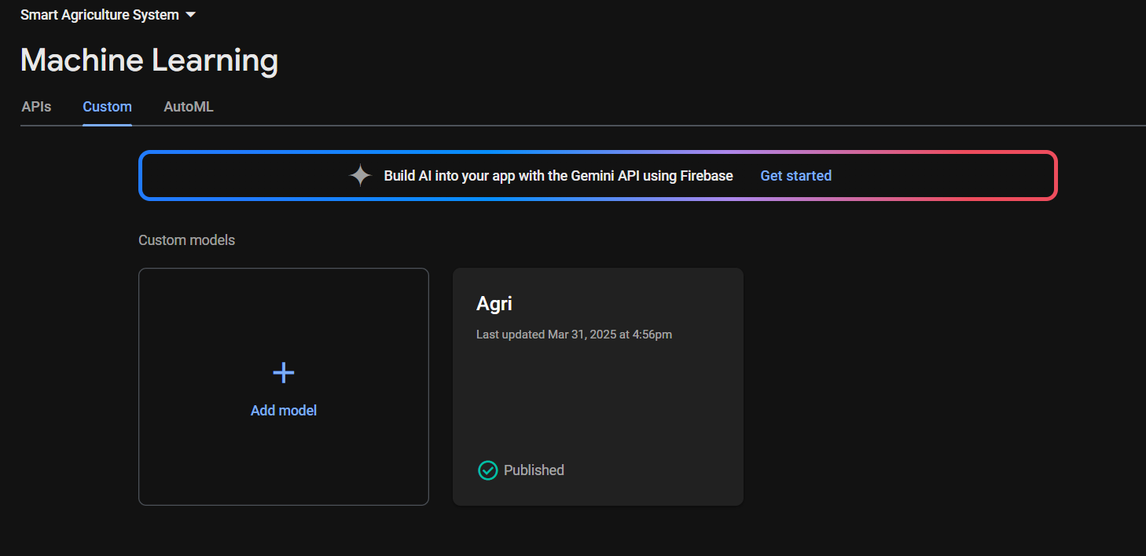
7. Upload Model to Firebase ML – Deploy the .tflite file for real-time predictions via ESP32.
ML Model Development
Department of Robotics and Automation Engineering Third Year (B.Tech.)

Slide 34
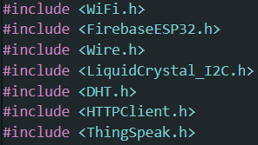

1.Include Required Libraries
2. Define WiFi.
ESP32 Code
Department of Robotics and Automation Engineering Third Year (B.Tech.)

Slide 35
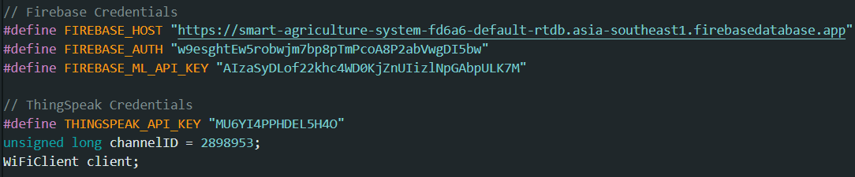
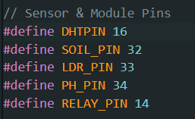
2. Define Firebase and ThingSpeak Credentials
3. Sensor & Actuator Pin Configuration
ESP32 Code
Department of Robotics and Automation Engineering Third Year (B.Tech.)

Slide 36
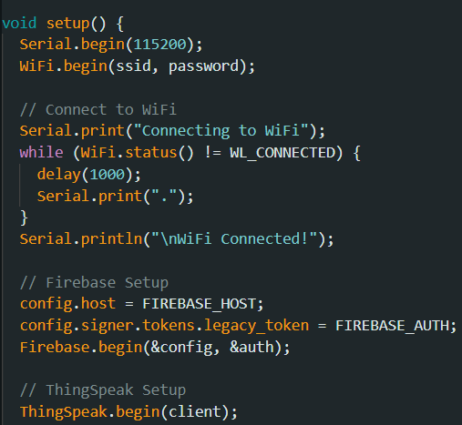
4. Setup Function: Initialize Connections
ESP32 Code
Department of Robotics and Automation Engineering Third Year (B.Tech.)

Slide 37
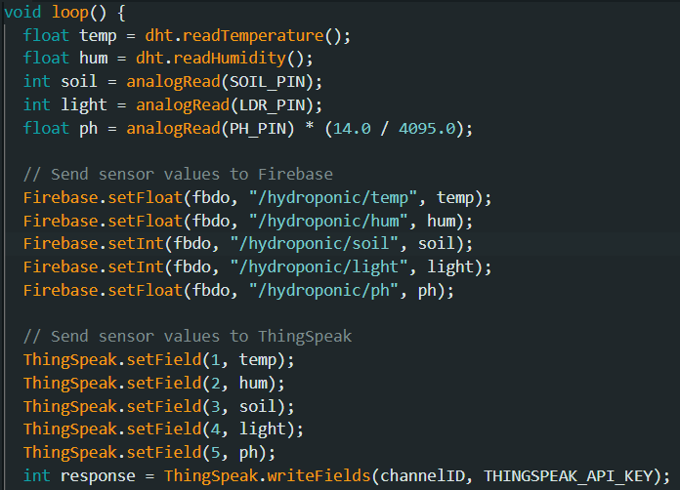
5. Read Sensor Data in Loop and send to Firebase and ThingSpeak
ESP32 Code
Department of Robotics and Automation Engineering Third Year (B.Tech.)

Slide 38
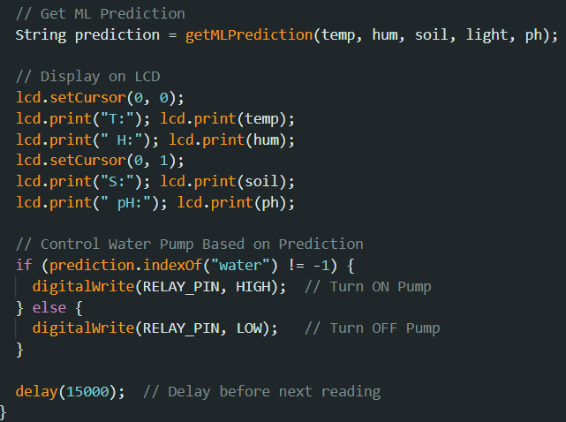
6. Controlling the Water Pump with ML Predictions and displaying values on lcd
ESP32 Code
Department of Robotics and Automation Engineering Third Year (B.Tech.)

Slide 39
Budget Details
SERIAL NO | Component | Quantity | Tentative Cost (₹)
1. | Esp32 : (ESP32 Development Board) | 1 | 549/-
2. | DHT11 Sensor : (DHT11 Sensor Module) | 1 | 51/-
3. | LDR Sensor : (4mm Photoresistor Photo Cell) | 1 | 10/-
4. | Relays : (Single Channel 5v 10A module) | 1 | 100/-
5. | Water Pump : (DC6-12V MINI Aquarium water Pump R385) | 1 | 199/-
6. | Soil Moisture Sensor : (Smart Elex Sensor) | 1 | 124/-
7. | DC-DC Buck Converter : (LM2596S) | 2 | 100/-
8. | Power Supply : (AC-DC Power Module 24V 4A) | 1 | 835/-
9. | LCD Display: 16x2 LCD (Green Backlight) | 1 | 198/-
10. | pH Sensor: Electrode Probe for Liquid pH Value | 1 | 1134/-
11. | Light: LBW 48 LEDs Grow light for indoor plant | 1 | 1200/-
12. | Others |  | 1500/-
 |  | Total | 6,000
Department of Robotics and Automation Engineering Third Year (B.Tech.)

Slide 40
Plan of Work
Sr. No | Activity | Tentative Date | Remark
1 | Finalize architecture, identify components, and procure hardware. | Week 1 | Completed
2 | Design circuits, assess feasibility, and procure remaining components. | Week 2 | Completed
3 | Set up ESP32, calibrate sensors and develop IoT monitoring. | Week 3 | Completed
4 | Build and test prototype,ensure cloud connectivity and integrate with ESP32. | Week 4 | Completed
5 | Verify connections, implement ML models, and integrate IoT cloud services. | Week 5 | Completed
6 | Test automation features, conduct real-world testing, and evaluate ML accuracy. | Week 6 | Completed
7 | Optimize resource efficiency, document findings, and prepare final presentation. | Week 7 | Work in progress
8 | Submit deliverables and conduct final project review. | Week 8 | Pending
Department of Robotics and Automation Engineering Third Year (B.Tech.)

Slide 41
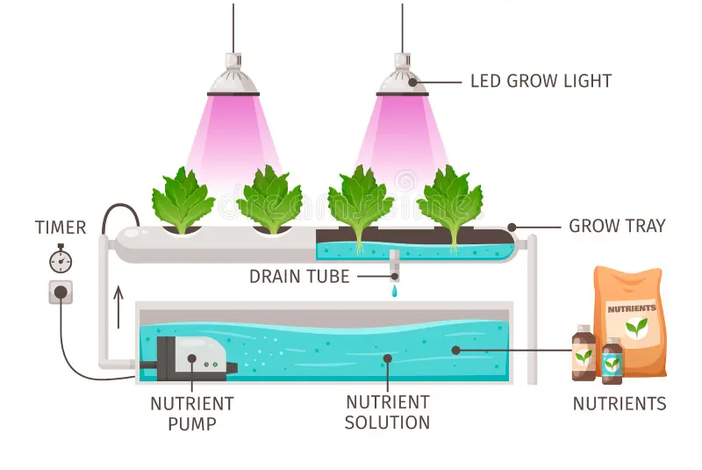
Expected Outcome
Department of Robotics and Automation Engineering Third Year (B.Tech.)

Slide 42
Expected Outcome
Expected Sensor Values for Aglaonema Growth:
Sensor | Optimal Value Range | Remarks
Temperature | 18°C - 30°C | Ideal for healthy growth. Avoid extreme heat/cold.
Humidity | 60% - 80% | High humidity supports better growth.
Soil Moisture | 60% - 80% | Keep the nutrient solution at optimal moisture.
Light Intensity | 1000 - 2500 Lux | Aglaonema prefers indirect light. Avoid direct sunlight.
pH Level | 5.5 - 6.5 | Best for nutrient absorption in hydroponics.
Department of Robotics and Automation Engineering Third Year (B.Tech.)

Slide 43
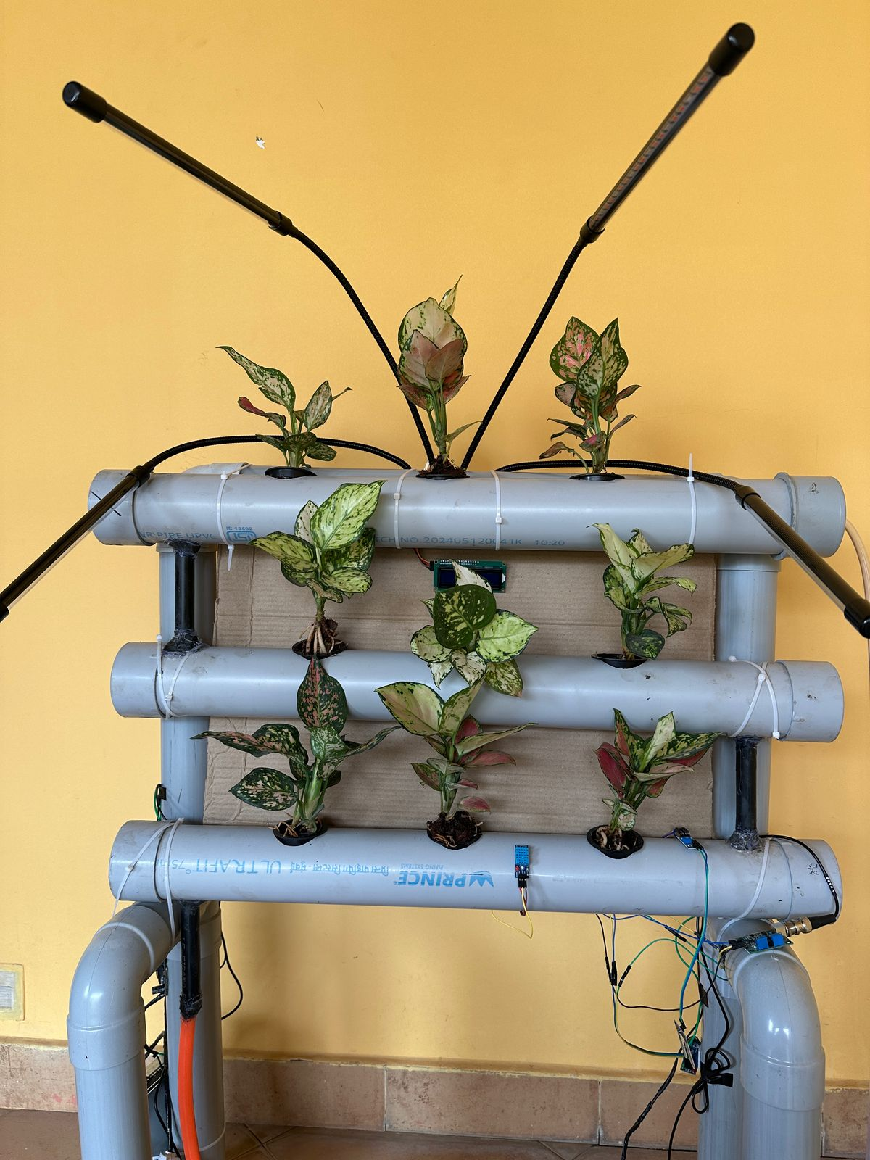
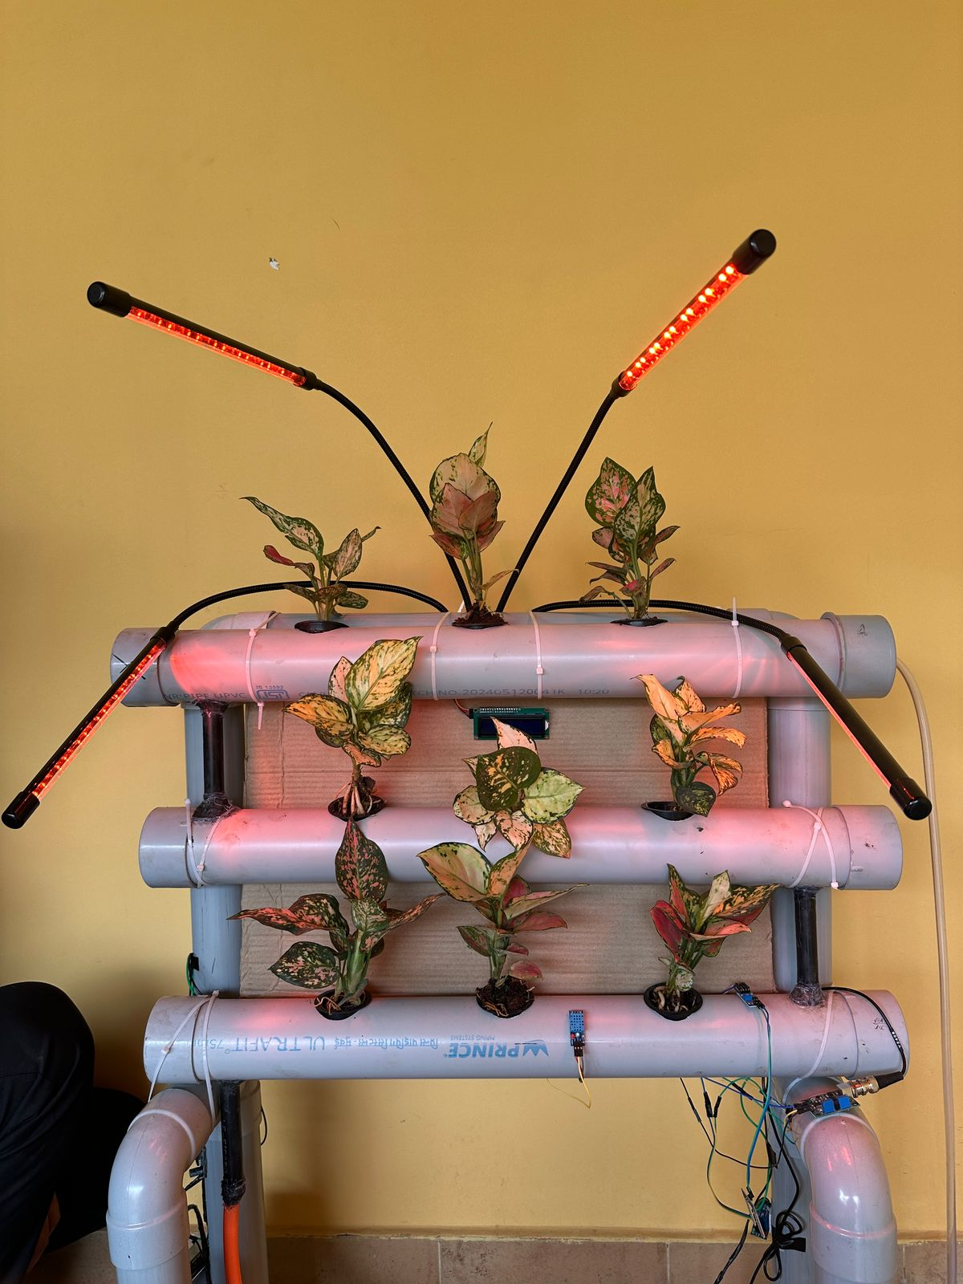
Results
Structure:
Department of Robotics and Automation Engineering Third Year (B.Tech.)

Slide 44
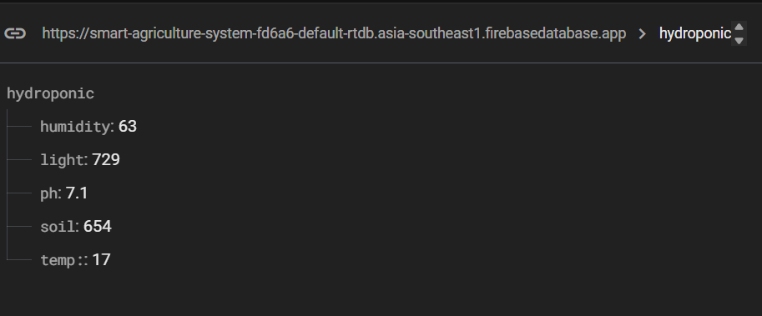
Results
Firebase :
Department of Robotics and Automation Engineering Third Year (B.Tech.)

Slide 45
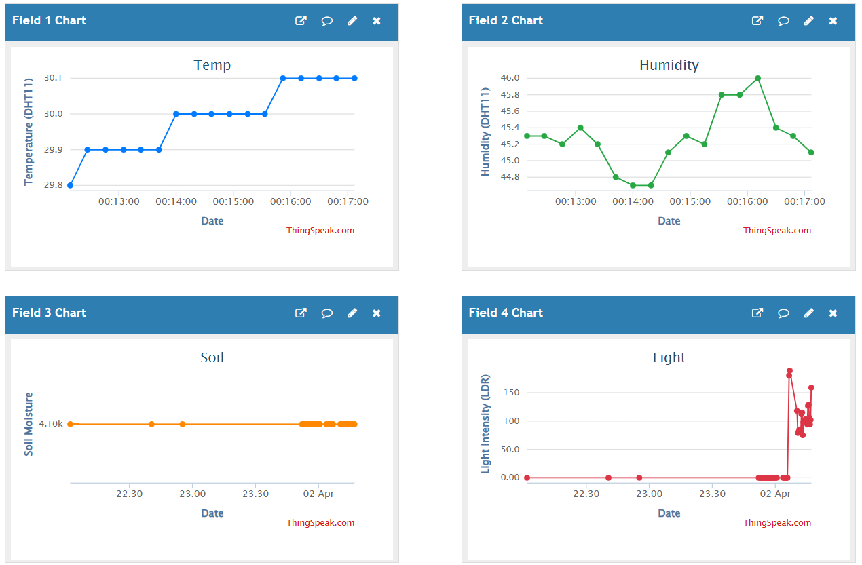
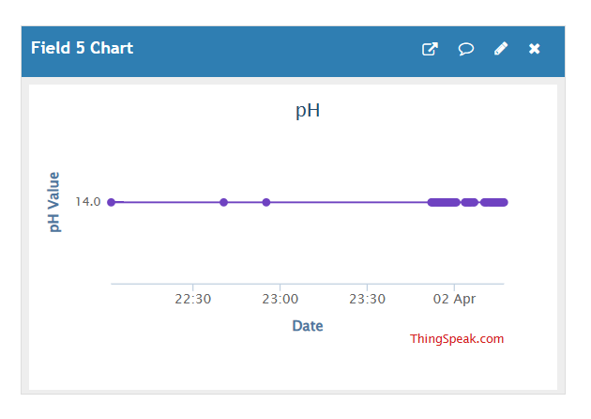
Results
ThingSpeak:
Department of Robotics and Automation Engineering Third Year (B.Tech.)

Slide 46
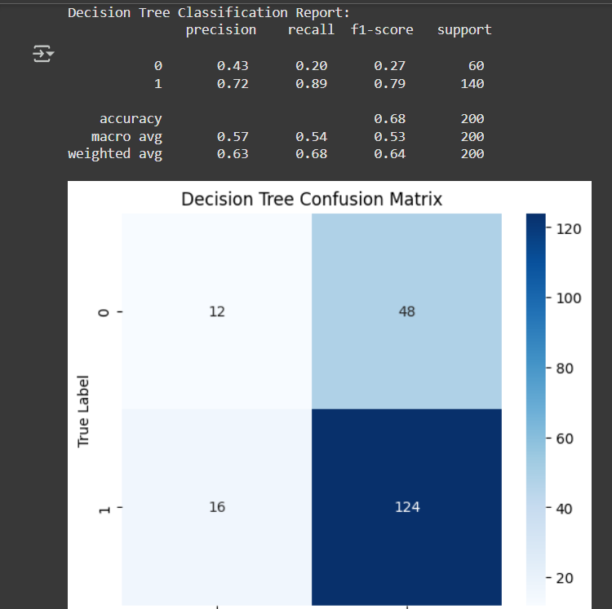
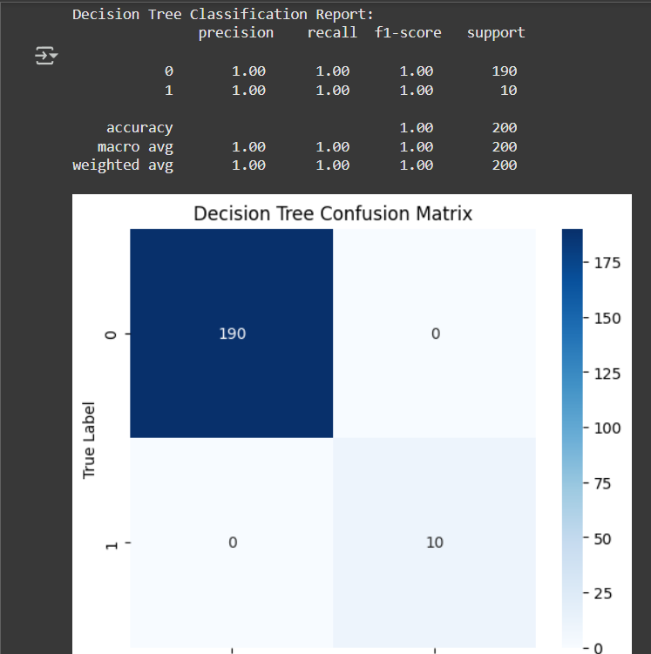
Results
DT Model: Synthetic Data Sensor Data
Department of Robotics and Automation Engineering Third Year (B.Tech.)

Slide 47
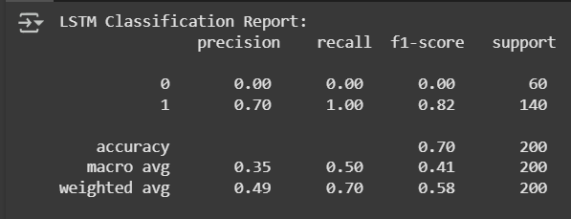
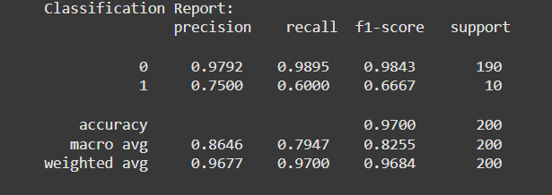
Results
LSTM Model:
Synthetic Data
Sensor Data
Department of Robotics and Automation Engineering Third Year (B.Tech.)

Slide 48
Conclusion
The Smart IoT-Based Hydroponic System integrates ESP32, cloud platforms like Firebase and ThingSpeak, and Machine Learning to automate and optimize plant growth. The system collects real-time data from DHT11, soil moisture, pH, and LDR sensors, processes it using ESP32, and sends it to the cloud for analysis. A trained DT & LSTM model predicts plant needs, enabling automated irrigation and light control.
Key Takeaways:
Real-time Monitoring – Sensor data is uploaded to Firebase and visualized on ThingSpeak.
Automated Control – Water pump operate based on sensor feedback and ML predictions.
Cloud & IoT Integration – Firebase stores sensor data, while ThingSpeak provides real-time graphs.
Machine Learning Optimization – The LSTM & DT model predict environmental needs for optimal growth.
Scalability & Energy Efficiency – The system can be expanded with more sensors and solar-powered options.
This project demonstrates how IoT and ML can revolutionize modern farming, making it more efficient, data-driven, and sustainable.
Department of Robotics and Automation Engineering Third Year (B.Tech.)

Slide 49
References
[1] K.Lakshmisudha, Swathi Hegde, Neha Kale, Shruti Iyer, “ Smart Precision Based Agriculture Using Sensors”, International Journal of Computer Applications (0975- 8887), Volume 146-No.11, July 2011
[2] Nikesh Gondchawar, Dr. R.S.Kawitkar, “IoT Based Smart Agriculture”, International Journal of Advanced Research in Computer and Communication Engineering (IJARCCE), Vol.5, Issue 6, June 2016.
[3] M.K.Gayatri, J.Jayasakthi, Dr.G.S.Anandhamala, “Providing Smart Agriculture Solutions to Farmers for Better Yielding Using IoT”, IEEE International Conference on Technological Innovations in ICT for Agriculture and Rural Development (TIAR 2015).
[4] Chetan Dwarkani M, Ganesh Ram R, Jagannathan S, R. Priyatharshini, “Smart Farming System Using Sensors for Agricultural Task Automation”, IEEE International Conference on Technological Innovations in ICT for Agriculture and Rural Development (TIAR 2015).
[5] S. R. Nandurkar, V. R. Thool, R. C. Thool, “Design and Development of Precision Agriculture System Using Wireless Sensor Network”, IEEE International Conference on Automation, Control, Energy and Systems (ACES), 2014.
[6] Joaquín Gutiérrez, Juan Francisco Villa-Medina, Alejandra Nieto-Garibay, and Miguel Ángel PortaGándara, “Automated Irrigation System Using a Wireless Sensor Network and GPRS Module”, IEEE Transactions on Instrumentation and Measurements, 0018-9456,2013
Department of Robotics and Automation Engineering Third Year (B.Tech.)

Slide 50
References
[7] Dr. V .Vidya Devi,G. Meena Kumari, “Real- Time Automation and Monitoring System for Modernized Agriculture” ,International Journal of Review and Research in Applied Sciences and Engineering (IJRRASE) Vol3 No.1. PP 7-12, 2013.
[8] Meonghun Lee, Jeonghwan Hwang, Hyun Yoe, “Agricultural Protection System Based on IoT”, IEEE 16th International Conference on Computational Science and Engineering, 2013.
[9] Monika Jhuria, Ashwani Kumar, Rushikesh Borse, “Image Processing for Smart Farming: Detection of Disease and Fruit Grading”, IEEE Second International Conference on Image Information Processing (ICIIP), 2013.
[10] Orazio Mirabella and Michele Brischetto, “A Hybrid Wired/Wireless Networking Infrastructure for Greenhouse Management”, IEEE Transactions on Instrumentation and Measurement, vol. 60, no. 2, pp 398- 407, 2011.
[11] C. Liu, W. Ren, B. Zhang, and C. Lv, “The application of soil temperature measurement by lm35 temperature sensors”, International Conference on Electronic and Mechanical Engineering and Information Technology, vol. 88, no. 1, pp. 1825–1828, 2011.
[12] D.D.Chaudhary1, S.P.Nayse2, L.M.Waghmare, “Application of wireless sensor networks for greenhouse parameter control in precision agriculture”, International Journal of Wireless & Mob
Department of Robotics and Automation Engineering Third Year (B.Tech.)

Slide 51
References
[13] Patel, K., Patel, S., & Patel, P. (2017). "IoT-Based Hydroponic System for Smart Farming." International Conference on Computing, Communication and Automation (ICCCA).
[14] Kim, Y., Evans, R. G., & Iversen, W. M. (2008). "Remote Sensing and Control of an Irrigation System Using a Distributed Wireless Sensor Network." IEEE Transactions on Instrumentation and Measurement.
[15] Prathibha, S. R., Hongal, A., & Jyothi, M. P. (2017). "IoT-Based Monitoring System in Smart Agriculture." International Conference on Recent Advances in Electronics and Communication Technology (ICRAECT).
[16] Ramesh, V., & Kavithamani, M. (2018). "Machine Learning-Based Smart Irrigation System for Efficient Water Management." IEEE International Conference on Intelligent Techniques in Control, Optimization, and Signal Processing (INCOS).
[17] Mukherjee, A., & Maity, R. (2019). "Smart Irrigation Using Machine Learning: A Review." IEEE Access, 7, 9043-9057.
[18] Abdullahi, B., & Mahieddine, M. (2020). "IoT-Based Smart Agriculture: A Review on Architecture, Applications, and Challenges." IEEE International Conference on Computer and Communications.
Department of Robotics and Automation Engineering Third Year (B.Tech.)

Slide 52
References
[19] Kumar, R., & Rajasekaran, M. P. (2016). "An IoT-Based Smart Agriculture System Using Machine Learning." International Conference on Wireless Communications, Signal Processing, and Networking (WiSPNET).
[20] Sharma, A., & Tripathi, R. (2019). "AI and IoT in Agriculture: A Review on Automation and Precision Farming." IEEE International Conference on Emerging Trends in Engineering.
[21] Maheswari, S., & Selvakumar, S. (2018). "A Cloud-Based IoT Smart Irrigation System Using Machine Learning." International Journal of Applied Engineering Research.
[22] Pandey, R., & Chaudhari, M. (2020). "Deep Learning for Plant Disease Detection in Precision Agriculture." IEEE International Conference on Advances in Computing, Communication, and Control (ICACCC).
[23] Silva, D. C., & Souza, F. J. (2021). "A Predictive Smart Farming Model Using IoT and Big Data Analytics." IEEE Latin America Transactions.
[24] Zhang, X., & Sun, Y. (2022). "Enhancing Smart Agriculture With Edge Computing and AI: A Survey." IEEE Internet of Things Journal.
Department of Robotics and Automation Engineering Third Year (B.Tech.)

